Slide 1
DATA MODELS
Chapter 2

Slide 2
Basic Concepts
Entity
An entity is a “thing” or “object” in the real world that is distinguishable from all other objects.
For example, each person in an enterprise is an entity.
Entity Set
An entity set is a set of entities of the same type that share the same properties, or attributes.
The set of all persons who are customers at a given bank, for example, can be defined as the entity set customer.
A relationship is an association among several entities.
For example, we can define a relationship that associates customer Hayes with loan L-15.
A relationship set is a set of relationships of the same type
Consider the two entity sets customer and loan. We define the relationship set borrower to denote the association between customers and the bank loans that the customers have.

Slide 3
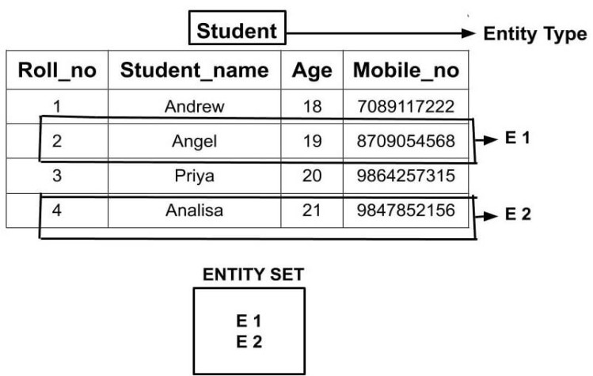
Entity vs Entity set

Slide 4
Attributes
Attributes are descriptive properties possessed by each member of an entity set.
Possible attributes of the customer entity set are customer-id, customer-name, customer-street, and customer-city.
Types of Attribute
Simple attributes
composite attributes
Single-valued Attributes
multivalued attributes
Derived attribute
Null value

Slide 5
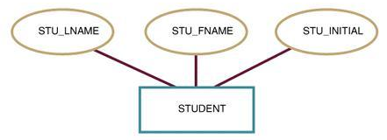
1. Simple attributes
Attributes that are not divided into subparts

Slide 6
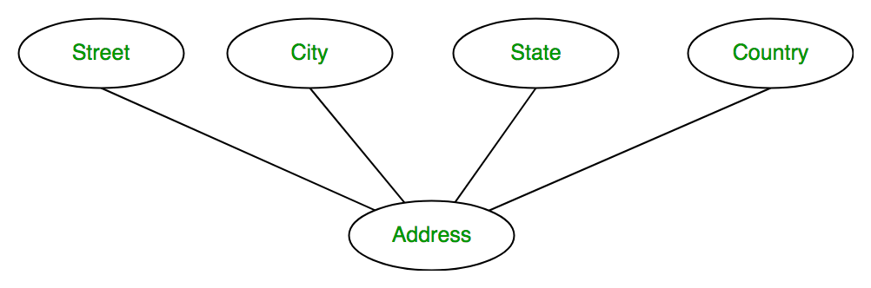
2. Composite attributes
Composite attributes, on the other hand, can be divided into subparts

Slide 7
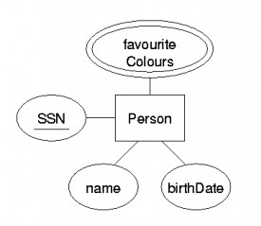
3. Single value and Multivalued Attribute
SSN attribute for a specific person entity refers to only one Person number. Such attributes are said to be single valued
Person may have zero, one, or several favorite_colors, and different Person may have different favorite colors. This type of attribute is said to be multivalued
Multivalued
Key Attibute

Slide 8
4. Derived attribute
The value for this type of attribute can be derived from the values of other related attributes or entities.
STUDENT
DOB
AGE

Slide 9
5. Null Attribute
An attribute takes a null value when an entity does not have a value for it. The null value may indicate “not applicable”—that is, that the value does not exist for the entity

Slide 10
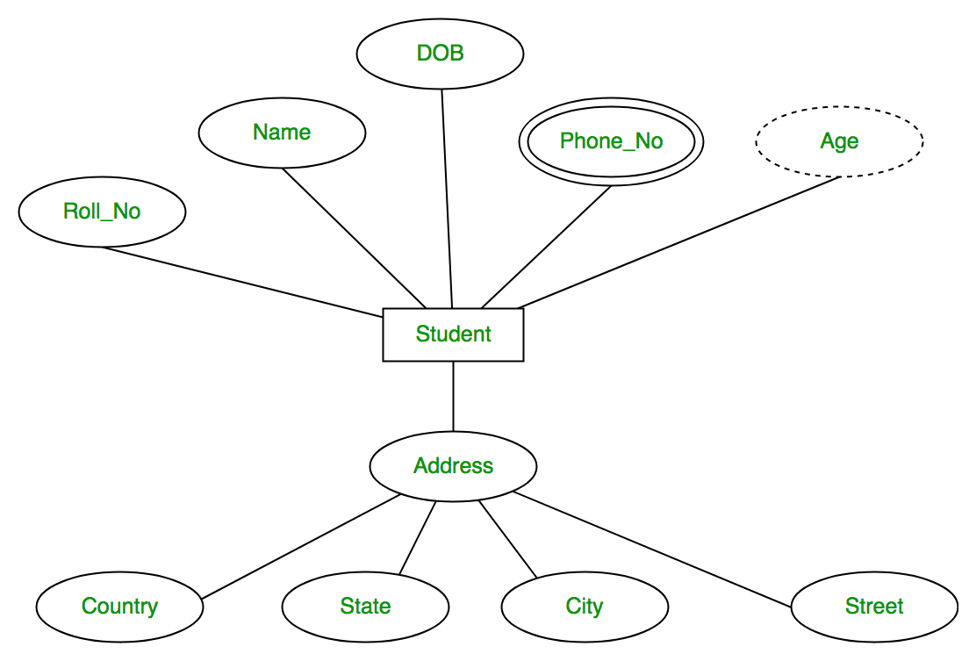
Find types of attributes.

Slide 11
Mapping Cardinalities & connectivity
Mapping cardinalities express the number of entities to which another entity can be associated via a relationship set.
For a binary relationship set R between entity sets A and B, the mapping cardinality must be one of the following:
R
A
B

Slide 12
One to one
An entity in A is associated with at most one entity in B, and an entity in B is associated with at most one entity in A.
Dean
1
manages
1
University

Slide 13
One to many
An entity in A is associated with any number (zero or more) of entities in B. An entity in B, however, can be associated with at most one entity in A.
Teacher
1
teaches
M
Students

Slide 14
Many to one
An entity in A is associated with at most one entity in B. An entity in B, however, can be associated with any number (zero or more) of entities in A
Car
M
Owned_by
1
owner

Slide 15
Many to many
An entity in A is associated with any number (zero or more) of entities in B, and an entity in B is associated with any number (zero or more) of entities in A.
Subject
N
teachers
M
Teacher

Slide 16
Connectivity
Car
Teacher
0..1
0..N
owns
teachers
1
0..1
Owner
Subject

Slide 17
Participation Constraints
The participation of an entity set E in a relationship set R is said to be total if every entity in E participates in at least one relationship in R.
If only some entities in E participate in relationships in R, the participation of entity set E in relationship R is said to be partial.
LOAN
BORROWS
CUSTOMER
Total Participation
Partial
Participation

Slide 18
Degree of a relationship
The degree of a relationship is the number of entity types that participate in the relationship.
The three most common relationships in ER models are
Unary
Binary
Ternary [N-Array]

Slide 19
1) Unary relationship
A unary relationship is when both participants in the relationship are the same entity.
Is also known as recursive relationship set or Role indicator
M
EMPLOYEE
MANAGES
1

Slide 20
2) Binary relationship
A binary relationship is when two entities participate and is the most common relationship degree.
Teaches
Teacher
Subject

Slide 21
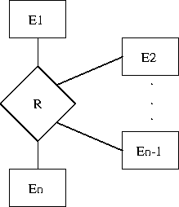
3) N-Array relationship
A n-array relationship is when more then two entities participate in the relationship.
Teaches
Teacher
Subject
course

Slide 22

KEYS

Slide 23
Keys
attribute values of an entity must be such that no two entities in an entity set are allowed to have exactly the same value for all attributes.
uniquely identify the entity
Keys also help uniquely identify relationships, and thus distinguish relationships from each other

Slide 24
Types of keys
Super keys
A super key is a set of one or more attributes that, taken collectively, allow us to identify uniquely an entity in the entity set.
Simply, a super key is a group of single or multiple keys which identifies rows in a table
Candidate keys
A candidate is a subset of a super key.
A candidate key is a single field or the least combination of fields that uniquely identifies each record in the table.
Every table must have at least one candidate key but at the same time can have several.

Slide 25
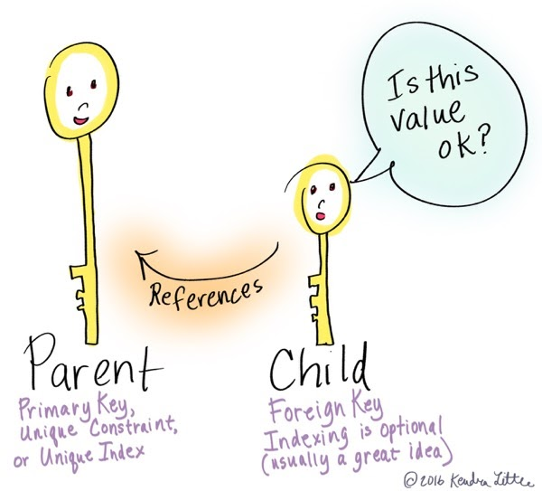

Slide 26
Types of keys
Primary Key
A primary key is a candidate key that is most appropriate to be the main reference key for the table.
primary key must contain unique values, must never be null and uniquely identify each record in the table.
Foreign Key
A foreign key is generally a primary key from one table that appears as a field in another where the first table has a relationship to the second.
Secondary Key or Alternative Key
One is selected as the primary key. Those not selected are known as alternative keys.
Composite Key
In some entity set a single attribute cannot be used to uniquely identify entities.

Slide 27
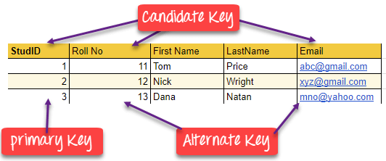

Slide 28
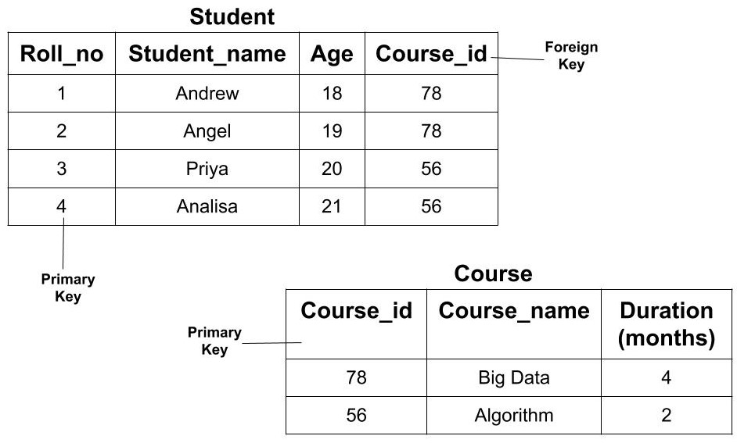
Primary Key and Foreign Key

Slide 29
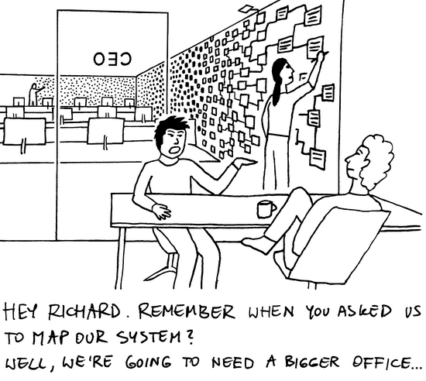

Slide 30
Design issues
The notions of an entity set and a relationship set are not precise, and it is possible to define a set of entities and the relationships among them in a number of different ways.
In this section, we examine basic issues in the design of an E-R database schema.

Slide 31
a) Use of Entity Sets versus Attributes
Consider the entity set employee with attributes employee-name and telephone-number.
If we take different point of view, we must redefine the employee entity set as:
The employee entity set with attribute employee-name
The telephone entity set with attributes telephone-number and location
The relationship set emp-telephone, which denotes the association between employees and the telephones that they have
treating a telephone as an entity in situation where one may want to keep extra information about a telephone
such as its location, or its type (mobile, video phone, or plain old telephone), or who all share the telephone.
it would not be appropriate to treat the attribute employee-name as an entity; it is difficult to argue that employee-name is an entity in its own right (in contrast to the telephone). Thus, it is appropriate to have employee-name as an attribute of the employee entity set.

Slide 32
Emp_Name
Tel_No
Department
Emp_Name
Tel_No
EMPLOYEE
EMPLOYEE
Emp_TelNo
Tel_Number

Slide 33
b) Use of Entity Sets versus Relationship Sets
loan not as an entity, but rather as a relationship between customers and branches, with loan-number and amount as descriptive attributes.
1:1 is satisfactory as a relationship.
cannot represent conveniently a situation in which several customers hold a loan jointly.
Two problems arise as a result of the replication:
the data are stored multiple times, wasting storage space, and
updates potentially leave the data in an inconsistent state,
values differ in two relationships for attributes that are supposed to have the same value. (normalization solution)

Slide 34
Placement of Relationship Attributes
attributes of 1:1 or 1:N relationship sets can be associated with one of the participating entity sets, rather than with the relationship set.
depositor is a 1:N relationship set such that one customer may have several accounts, but each account is held by only one customer.
the attribute access-date, which specifies when the customer last accessed that account, could be associated with the account entity set

Slide 35
Entity-Relationship Diagram
Rectangles -> entity sets
Ellipses -> attributes
Diamonds -> relationship sets
Lines, link attributes ,entity and relationship
Double ellipses -> multivalued attributes
Dashed ellipses -> derived attributes
Double lines- >total participation
Double rectangles -> weak entity sets

Slide 36
Basic ER-Diagram
Name
Name
T_ID
Subject
Name
S_ID
teachers
Teacher
Student

Slide 37
Attributes in ER-Diagram

Slide 38
E-R diagram with role indicators.

Slide 39
Cardinality limits on relationship sets

Slide 40
Weak Entity Sets
An entity set may not have sufficient attributes to form a primary key. Such an entity set is termed a weak entity set.
In other word, if entities existence depends on other entities then entity is said to be weak entity set.
entity set that has a primary key is termed a strong entity set.

Slide 41
Extended E-R Features
the extended E-R features
specialization
Generalization
higher- and lower-level entity sets
attribute inheritance and
aggregation

Slide 42
Specialization
An entity set may include sub-groupings of entities that are distinct in some way from other entities in the set
entity set person, with attributes name, street, and city.
A person classified as one of the following:
customer
employee
The specialization of person allows us to distinguish among persons according to whether they are employees or customers.

Slide 43
Generalization
Generalization is a containment relationship that exists between a higher-level entity set and one or more lower-level entity sets.
person is the higher-level entity set and customer and employee are lower-level entity sets
Higher- and lower-level entity sets also may be designated by the terms superclass and subclass, respectively.

Slide 44
Generalization And Specialization

Slide 45
Attribute Inheritance
The attributes of the higher-level entity sets are said to be inherited by the lower-level entity sets.
For example, customer and employee inherit the attributes of person
customer is described by its name, street, and city attributes, and additionally a customer-id attribute; employee is described by its name, street, and city attributes, and additionally employee-id and salary attributes

Slide 46
Aggregation
Aggregation is an abstraction through which relationships are treated as higher-level entities
Example: we regard the relationship set works-on (relating the entity sets employee, branch, and job) as a higher-level entity set called works-on.
create a binary relationship manages between works-on and manager to represent who manages what tasks

Slide 47
E-R diagram with redundant relationships.

Slide 48
E-R diagram with aggregation.

Slide 49
Case Studies
Car Insurance Company
Airlines
A university registrar’s office

Slide 50
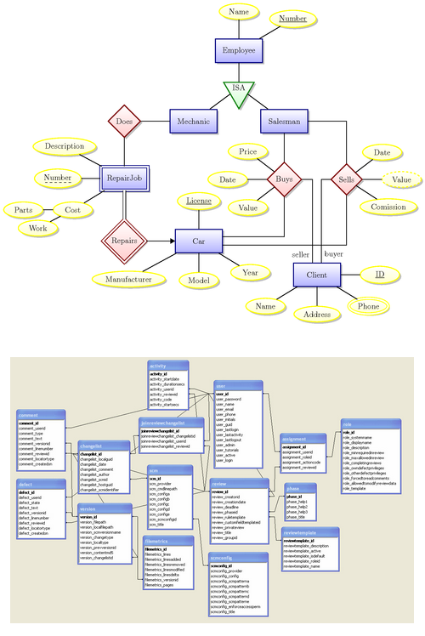
Design of an E-R Database Schema

Slide 51
Design of an E-R Database Schema
consider how a database designer may select from the wide range of alternatives. Among the designer’s decisions are:
Whether to use an attribute or an entity set to represent an object
Whether a real-world concept is expressed more accurately by an entity set or by a relationship set
Whether to use a ternary relationship or a pair of binary relationships
Whether to use a strong or a weak entity set;
weak entities are existence dependent on a strong entity

Slide 52
Whether using generalization is appropriate:
generalization, or a hierarchy of ISA relationships, contributes to modularity by allowing common attributes of similar entity sets to be represented in one place in an E-R diagram
Whether using aggregation is appropriate;
aggregation groups a part of an E-R diagram into a single entity set, allowing us to treat the aggregate entity set as a single unit without concern for the details of its internal structure.

Slide 53
ER- Diagram with examples

Slide 54
Reduction of an E-R Schema to Tables
Tabular Representation of Strong Entity Sets
Tabular Representation of Weak Entity Sets
Tabular Representation of Relationship Sets
Redundancy of Tables
Combination of Tables
Composite Attributes
Multivalued Attributes
Tabular Representation of Generalization
Tabular Representation of Aggregation

Slide 55
Tabular Representation of Strong Entity Sets
Let E be a strong entity set with descriptive attributes a1, a2, . . . , an.
We represent this entity by a table called E with n distinct columns, each of which corresponds to one of the attributes of E.
E
a1 a2 a3 a4
Table Name : E
a2
a1
a1 | a2 | a3 | a4
…… | …… | …… | ……
…… | …… | …… | ……
…… | …… | …… | ……
a3
E
a4

Slide 56
Example – Strong Entity Set
SID
Name
SSN
Name
STUDENT
Advisor
Professor
Major
GPA
Dept
Table: Student
Table: Professor
SID | Name | Major | GPA
1234 | John | CS | 2.8
5678 | Mary | EE | 3.6
SSN | Name | Dept
9999 | Smith | Math
8888 | Lee | CS

Slide 57
Representation of Weak Entity Set
Weak Entity Set Cannot exists alone
To build a table/schema for weak entity set
Construct a table with one column for each attribute in the weak entity set
Remember to include discriminator
Augment one extra column on the right side of the table, put in there the primary key of the Strong Entity Set (the entity set that the weak entity set is depending on)
Primary Key of the weak entity set = Discriminator + foreign key

Slide 58
Example – Weak Entity Set
Parent_ID
Name
Age
Name
Parent
owns
Children
Address
Age | Name | Parent_ID
10 | Bart | 1234
8 | Lisa | 5678
* Primary key of Children is Parent_SID + Name

Slide 59
Representing Relationship Set Unary/Binary Relationship
For one-to-one relationship without total participation
Build a table with two columns, one column for each participating entity set’s primary key. Add successive columns, one for each descriptive attributes of the relationship set (if any).
For one-to-one relationship with one entity set having total participation
Augment one extra column on the right side of the table of the entity set with total participation, put in there the primary key of the entity set without complete participation as per to the relationship.

Slide 60
Example – One-to-One Relationship Set
Degree
SID
Name
Maj_ID
Student
study
Major
Major
GPA
SID | Maj_ID | Degree
9999 | 07 | 1234
8888 | 05 | 5678
Table : Study
* Primary key can be either SID or Maj_ID_Co

Slide 61
Example – One-to-One Relationship Set
Condition
SID
Name
S/N #
1:1 Relationship
Student
Have
Laptop
Laptop
S/N# Brand
Major
GPA
Brand
SID | Name | Major | GPA | S/N# | Condition
9999 | Bart | Economy | -4.0 | 123-456 | Own
8888 | Lisa | Physics | 4.0 | 567-890 | Loan
* Primary key can be either SID or LP_S/N

Slide 62
Representing Relationship Set Unary/Binary Relationship
For one-to-many relationship w/out total participation
Same thing as one-to-one
For one-to-many/many-to-one relationship with one entity set having total participation on “many” side
Augment one extra column on the right side of the table of the entity set on the “many” side, put in there the primary key of the entity set on the “one” side as per to the relationship.

Slide 63
Example – Many-to-One Relationship Set
Semester
SID
Name
SSN
Advisor
0..1
N:1 Relationship
Student
Professor
Major
GPA
Dept
Name
Table : Advisor
SID | SSN | Semester
9999 | 123-456 | Fall 2006
8888 | 567-890 | Fall 2005
* Primary key of this table is SID

Slide 64
Example – Many-to-One Relationship Set
Semester
SID
Name
SSN
N:1 Relationship
Student
Advisor
Professor
Major
GPA
Dept
Name
Table: Student
SID | Name | Major | GPA | SSN | Semester
9999 | Bart | Economy | -4.0 | 123-456 | Fall 2006
8888 | Lisa | Physics | 4.0 | 567-890 | Fall 2005
* Primary key of this table is SID

Slide 65
Representing Relationship Set Unary/Binary Relationship
For many-to-many relationship
Same thing as one-to-one relationship without total participation.
Primary key of this new schema is the union of the foreign keys of both entity sets.
No augmentation approach possible…

Slide 66
Representing Relationship Set N-ary Relationship
Intuitively Simple
Build a new table with as many columns as there are attributes for the union of the primary keys of all participating entity sets.
Augment additional columns for descriptive attributes of the relationship set (if necessary)
The primary key of this table is the union of all primary keys of entity sets that are on “many” side
That is it, we are done.

Slide 67
Example – N-ary Relationship Set
P-Key1
D-Attribute
A-Key
E-Set 1
P-Key2
A relationship
Another Set
E-Set 2
P-Key3
E-Set 3
P-Key1 | P-Key2 | P-Key3 | A-Key | D-Attribute
9999 | 8888 | 7777 | 6666 | Yes
1234 | 5678 | 9012 | 3456 | No
* Primary key of this table is P-Key1 + P-Key2 + P-Key3

Slide 68
Representing Composite Attribute
Relational Model Indivisibility Rule Applies
One column for each component attribute
NO column for the composite attribute itself
SSN
Name
SSN | Name | Street | City
9999 | Dr. Smith | 50 1st St. | Fake City
8888 | Dr. Lee | 1 B St. | San Jose
Professor
Address
Street
City

Slide 69
Representing Multivalue Attribute
For each multivalue attribute in an entity set/relationship set
Build a new relation schema with two columns
One column for the primary keys of the entity set/relationship set that has the multivalue attribute
Another column for the multivalue attributes. Each cell of this column holds only one value. So each value is represented as an unique tuple
Primary key for this schema is the union of all attributes

Slide 70
Example – Multivalue attribute
SID
Name
The primary key for this table is SID + tel_no, the union of all attributes
Student
Tel_No
Major
GPA
SID | Tel_No
1234 | 4491595
1234 | 4258236
5678 | 6658425
5678 | 568541
5678 | 5536254
SID | Name | Major | GPA
1234 | John | CS | 2.8
5678 | Homer | EE | 3.6

Slide 71
Representing Class Hierarchy
Two general approaches depending on disjointness and completeness
For non-disjoint and/or non-complete class hierarchy:
create a table for each super class entity set according to normal entity set translation method.
Create a table for each subclass entity set with a column for each of the attributes of that entity set plus one for each attributes of the primary key of the super class entity set
This primary key from super class entity set is also used as the primary key for this new table

Slide 72
SSN
Name
Person
SID
Status
Gender
ISA
Student
Major
GPA
SSN | Name | Gender
1234 | Homer | Male
5678 | Marge | Female
SSN | SID | Status | Major | GPA
1234 | 9999 | Full | CS | 2.8
5678 | 8888 | Part | EE | 3.6

Slide 73
Representing Class Hierarchy
Two general approaches depending on disjointness and completeness
For disjoint AND complete mapping class hierarchy:
DO NOT create a table for the super class entity set
Create a table for each subclass entity set include all attributes of that subclass entity set and attributes of the superclass entity set

Slide 74
SSN
Name
No table created for superclass entity set
people
SID
ISA
Student
Faculty
Disjoint and Complete mapping
Major
GPA
Dept
SSN | Name | SID | Major | GPA
1234 | John | 9999 | CS | 2.8
5678 | Mary | 8888 | EE | 3.6
SSN | Name | Dept
1234 | Homer | C.S.
5678 | Marge | Math

Slide 75
Representing Aggregation
Name
SSN
Name
Student
Advisor
Professor
SID
Dept
member
Dept
Code
Primary Key of Advisor
Name
SID | Code
1234 | 04
5678 | 08
Primary key of Dept

Slide 76
ER-Diagram Example

Slide 77
Question 1 :
Suppose you are given the following requirements for a simple database for the National Hockey League (NHL):
the NHL has many teams,
each team has a name, a city, a coach, a captain, and a set of players,
each player belongs to only one team,
each player has a name, a position (such as left wing or goalie), a skill level, and a set of injury records,
a team captain is also a player,
a game is played between two teams (referred to as host_team and guest_team) and has a date (such as May 11th, 1999) and a score (such as 4 to 2).
Construct a clean and concise ER diagram for the NHL database.

Slide 78
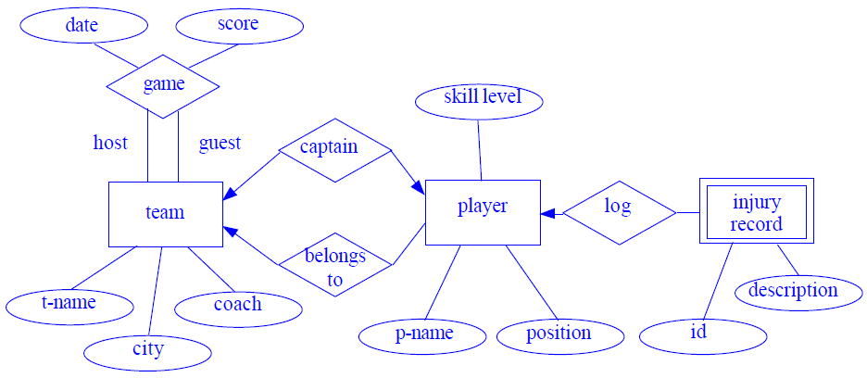
Solution

Slide 79
Question 2:
A university registrars office maintains data about the following entities:
courses, including number, title, credits, syllabus, and prerequisites;
course offerings, including course number, year, semester, section number, instructor(s), timings, and classroom;
students, including student-id, name, and program;
instructors, including identification number, name, department, and title.
Further, the enrollment of students in courses and grades awarded to students in each course they are enrolled for must be appropriately modeled. Construct an E-R diagram for the registrar’s office. Document all assumptions that you make about the mapping constraints.

Slide 80
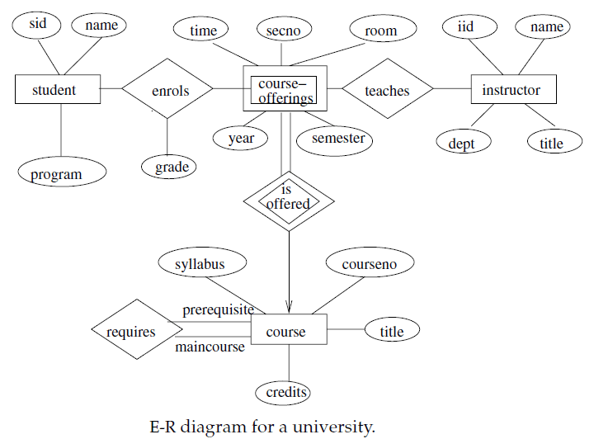
Solution 2:

Slide 81
Question 3:
Construct an E-R diagram for a car-insurance company whose customers own one or more cars each. Each car has associated with it zero to any number of recorded accidents.
Construct appropriate tables for the above ER Diagram ?

Slide 82
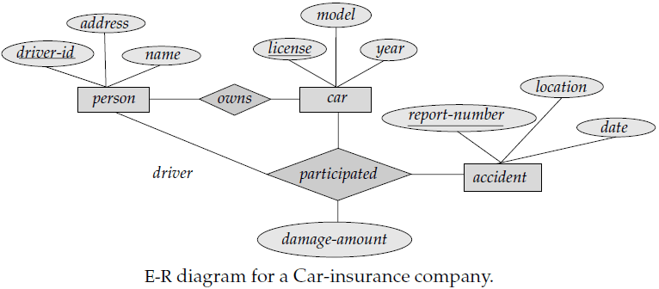
Solution 3 A:

Slide 83
Solution 3 B:
Car insurance tables:
person (driver-id, name, address)
car (license, year,model)
accident (report-number, date, location)
participated(driver-id, license, report-number, damage-amount)

Slide 84
Question 4:
Consider a database used to record the marks that students get in different exams of different course offerings.
a) Construct an E-R diagram that models exams as entities, and uses a ternary relationship, for the above database.
b) Construct an alternative E-R diagram that uses only a binary relationship between students and course-offerings. Make sure that only one relationship exists between a particular student and course-offering pair, yet you can represent the marks that a student gets in different exams of a course offering.

Slide 85
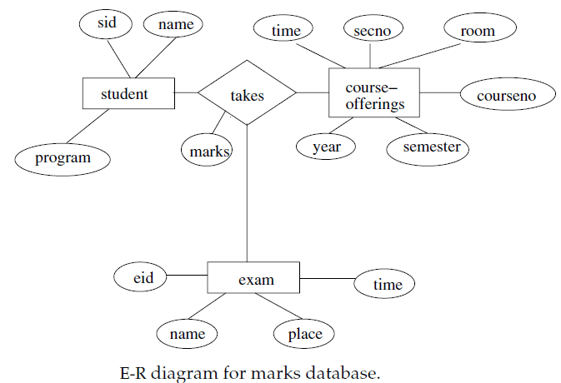
Solution 4 a:

Slide 86
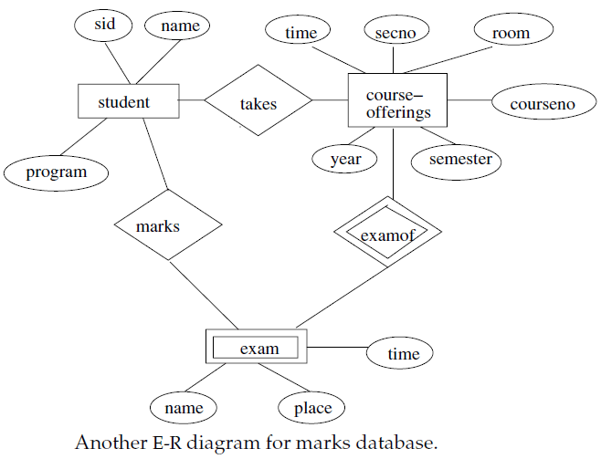
Solution 4 b:

Slide 87
Question 5:
Design an E-R diagram for keeping track of the exploits of your favorite sports team. You should store the matches played, the scores in each match, the players in each match and individual player statistics for each match. Summary statistics should be modeled as derived attributes.
Extend the E-R diagram of the previous question to track the same information for all teams in a league.

Slide 88
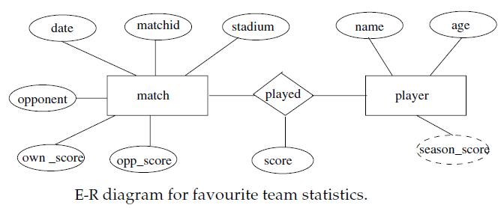
Solution 5 a:

Slide 89
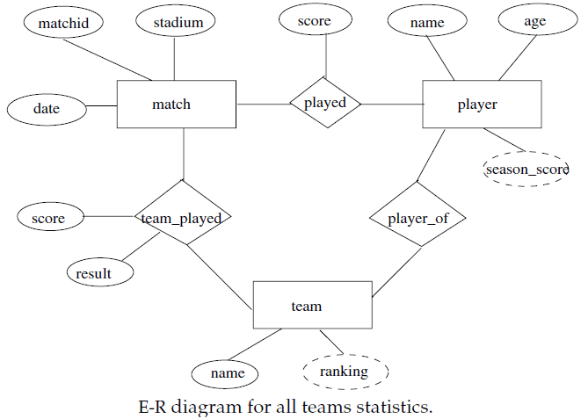
Solution 5 b:

